Slide 1



Airbnb - Paris Dataset
View in Power BI
Last data refresh:
12/18/2023 1:50:46 PM UTC
Downloaded at:
12/18/2023 2:22:21 PM UTC

Slide 2
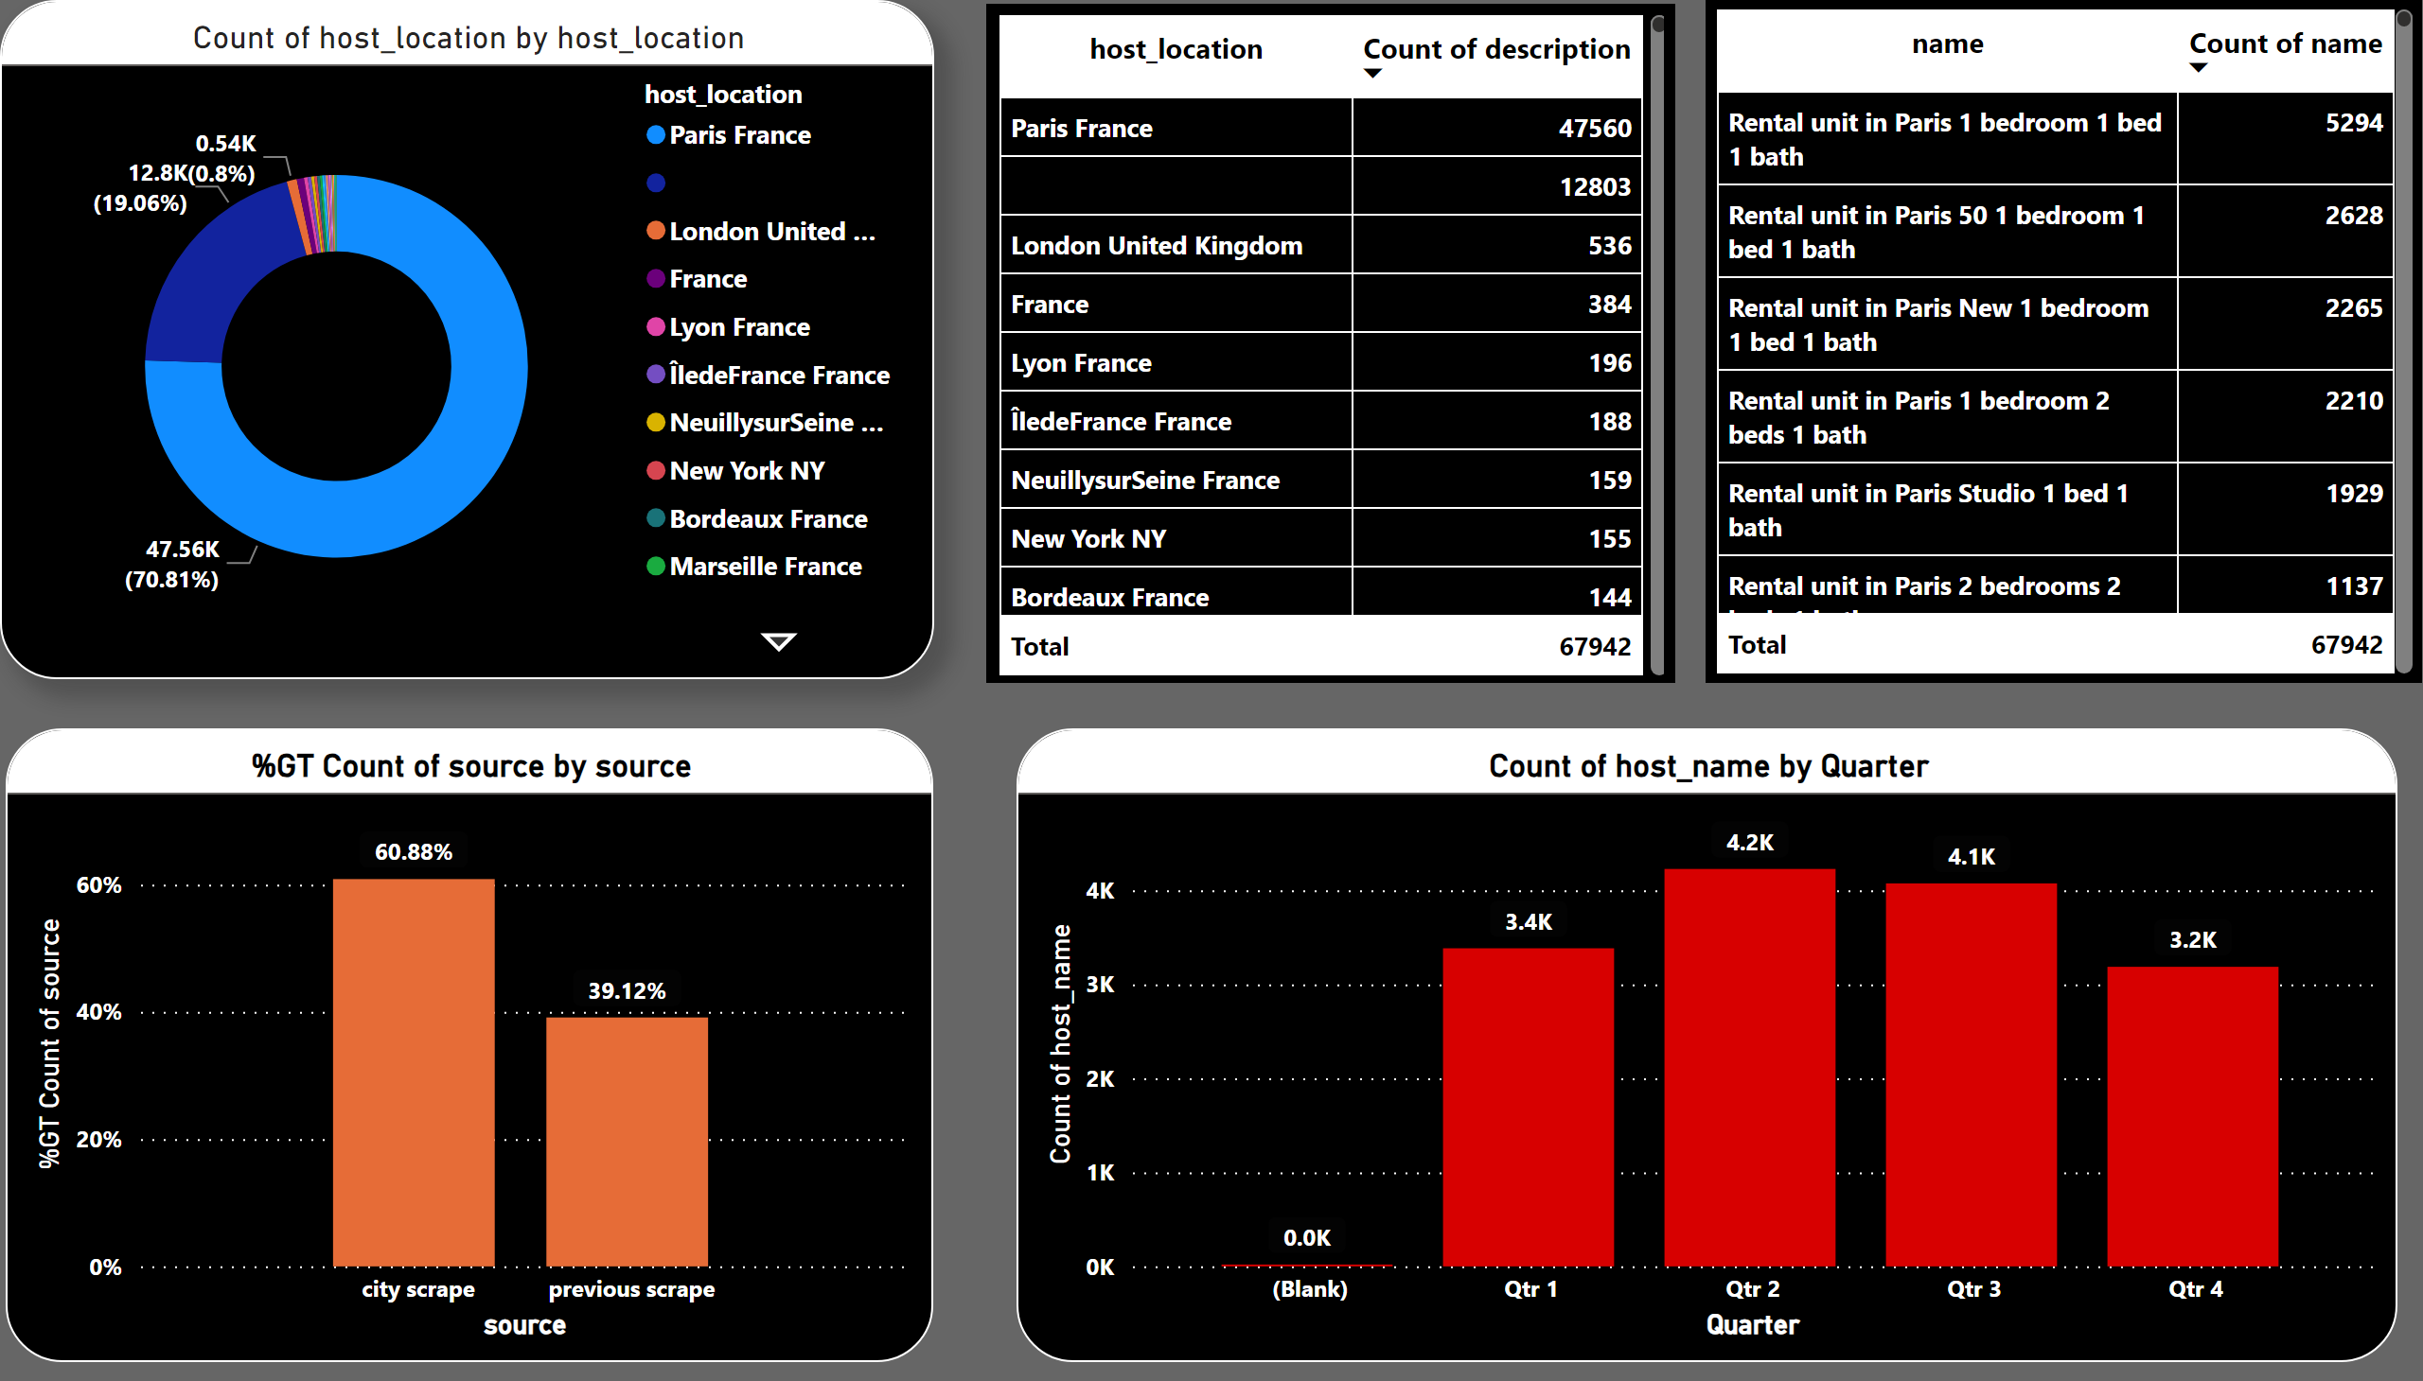
Page 1
Notes:
donutChart
No alt text provided
tableEx
No alt text provided
columnChart
No alt text provided
tableEx
No alt text provided
clusteredColumnChart
No alt text provided

Slide 3
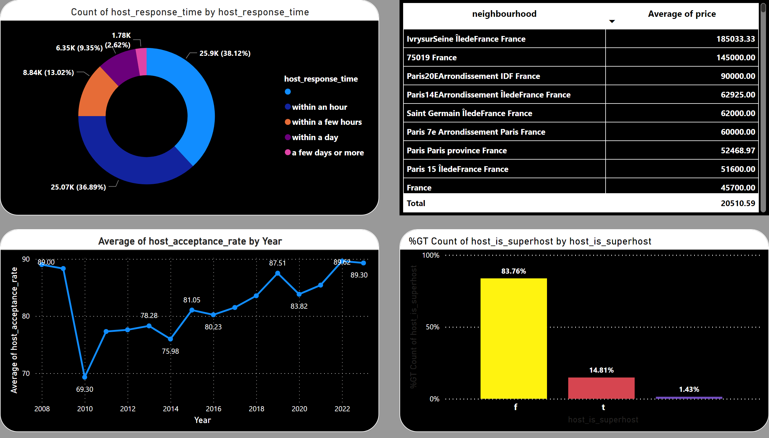
Page 2
Notes:
donutChart
No alt text provided
lineChart
No alt text provided
tableEx
No alt text provided
columnChart
No alt text provided

Slide 4
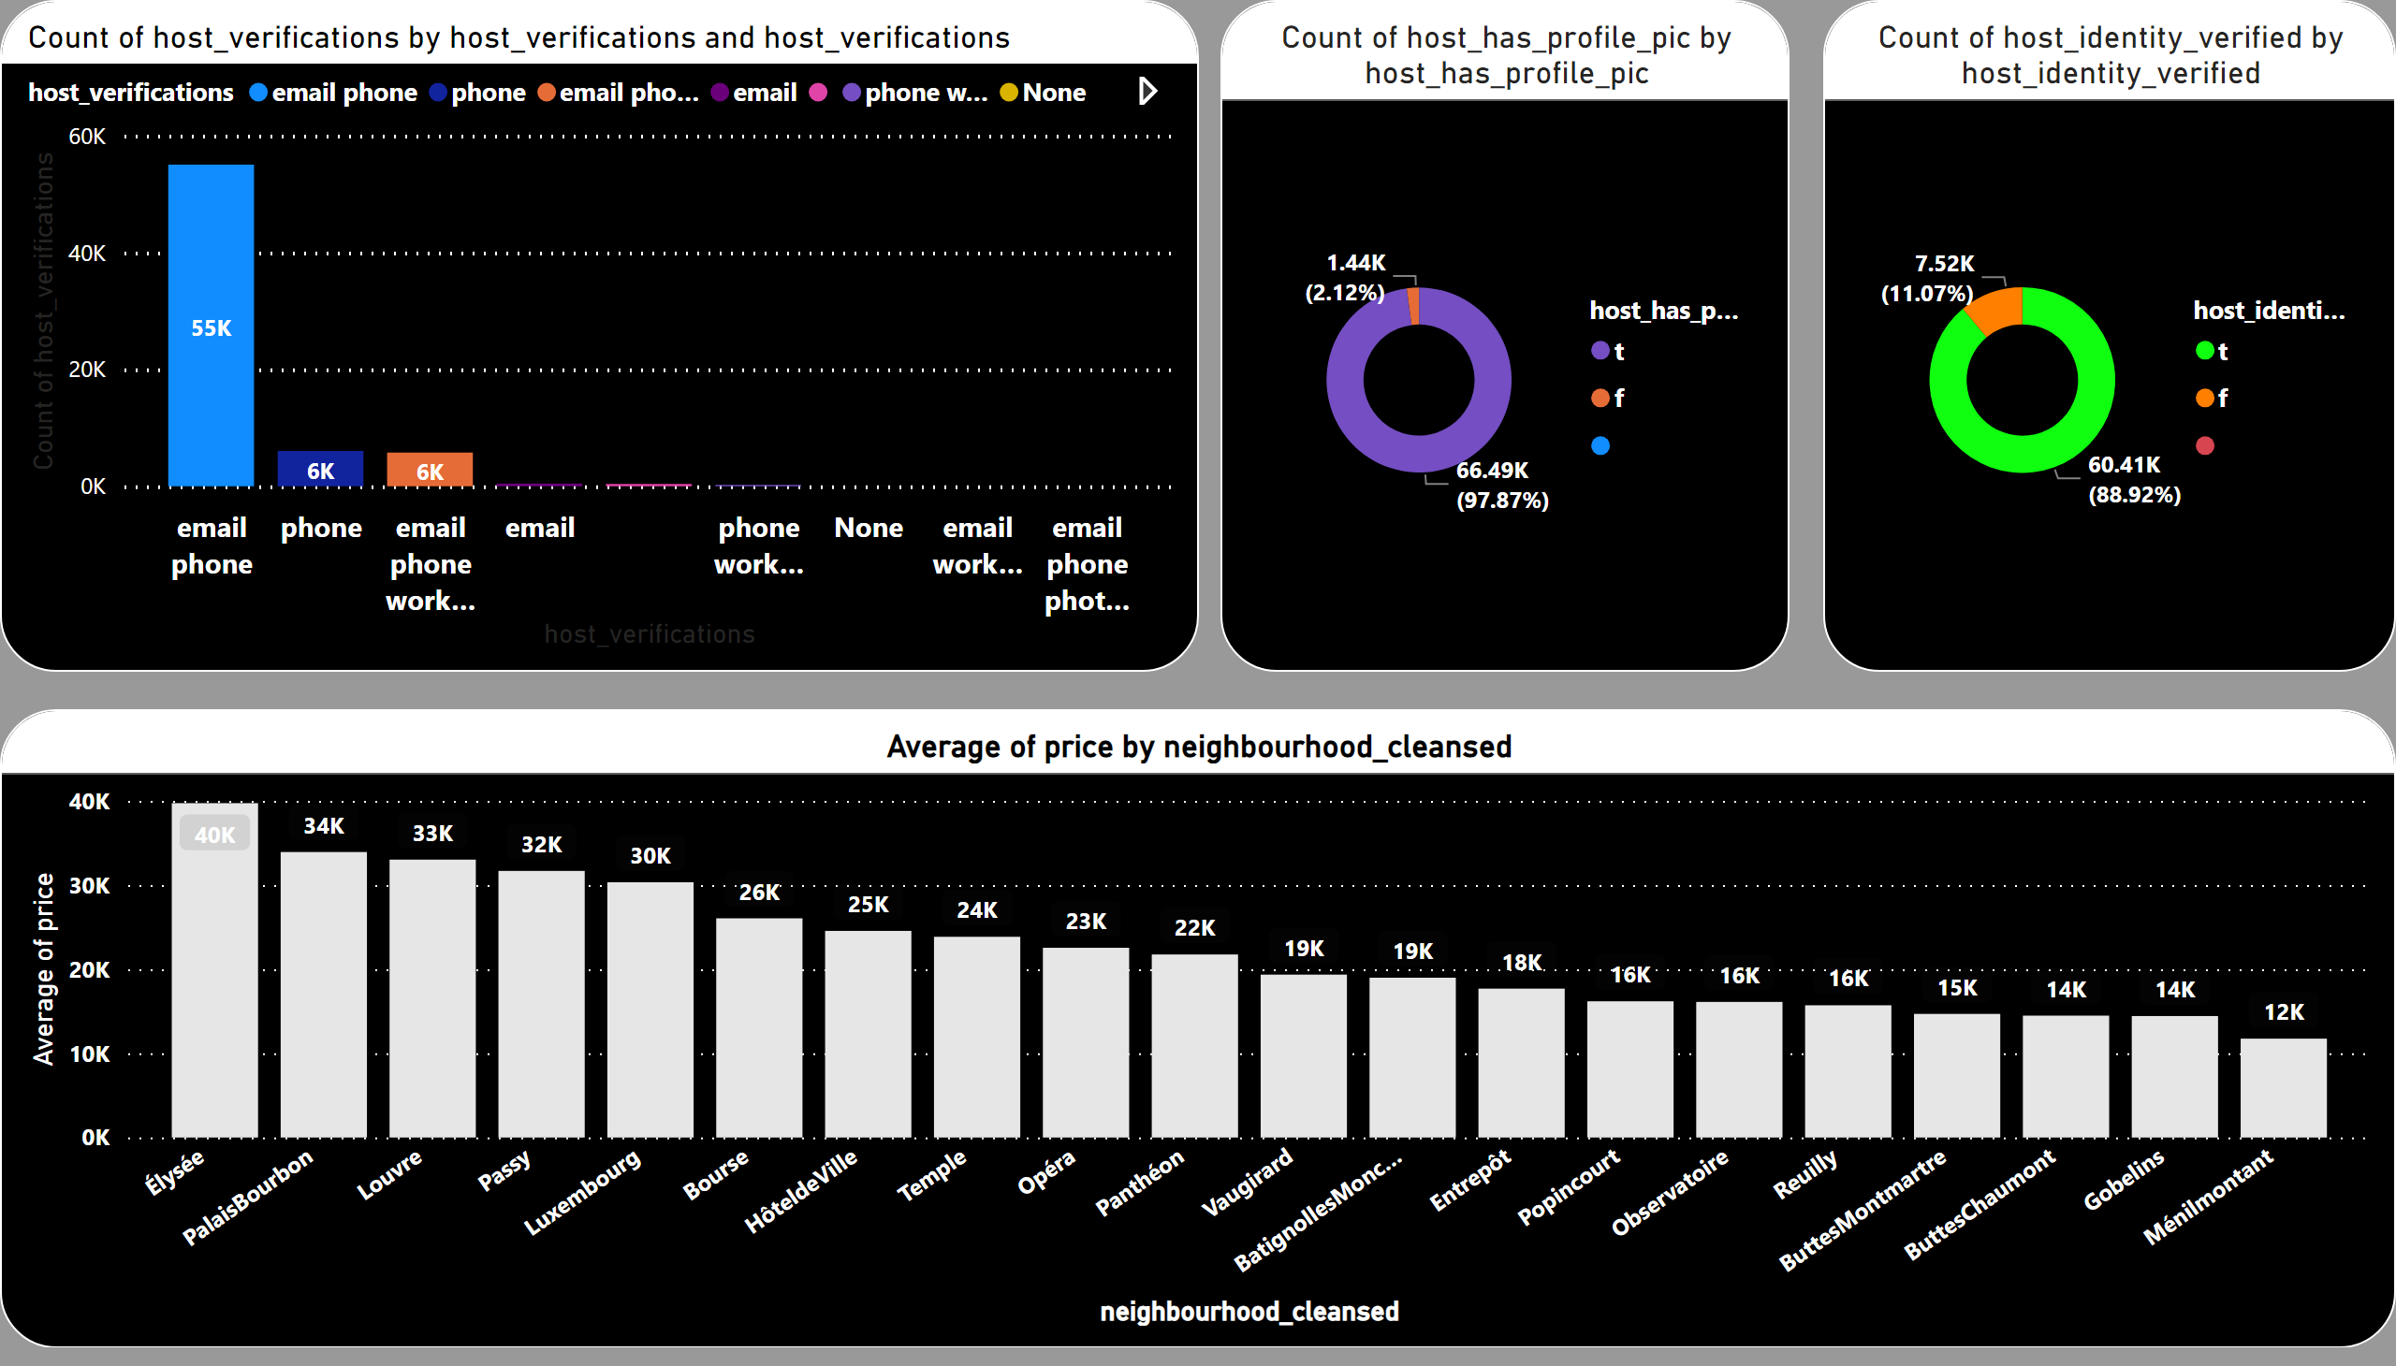
Page 3
Notes:
columnChart
No alt text provided
donutChart
No alt text provided
donutChart
No alt text provided
columnChart
No alt text provided

Slide 5
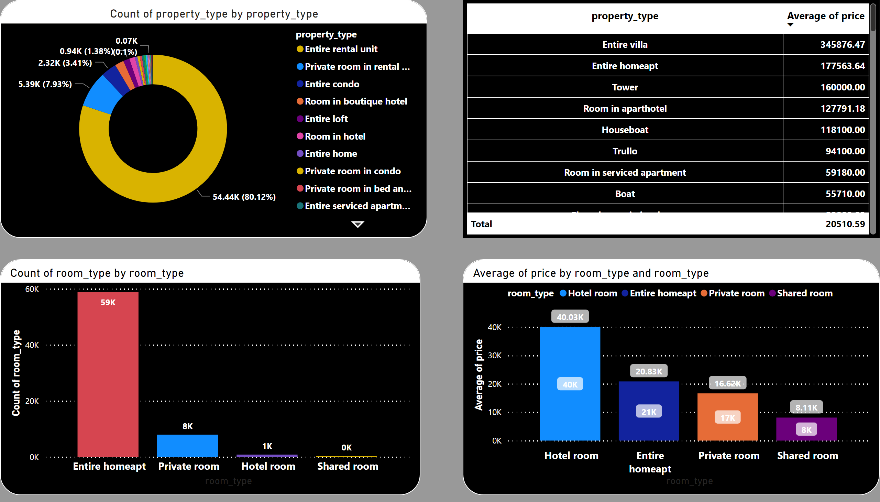
Page 4
Notes:
tableEx
No alt text provided
donutChart
No alt text provided
columnChart
No alt text provided
lineStackedColumnComboChart
No alt text provided

Slide 6
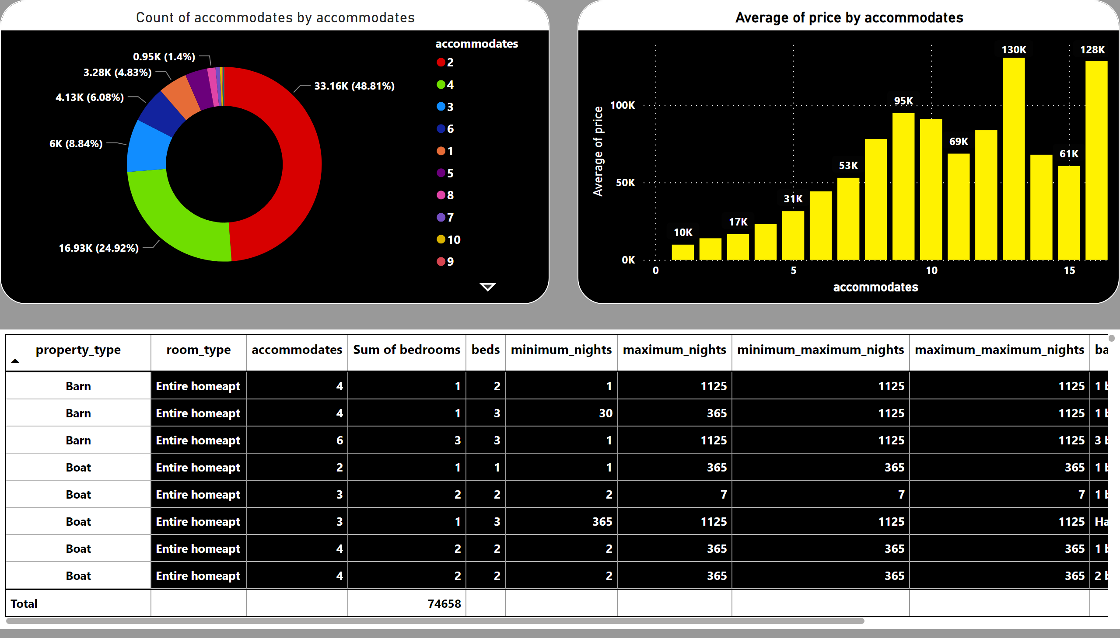
Page 5
Notes:
donutChart
No alt text provided
columnChart
No alt text provided
tableEx
No alt text provided

Slide 7
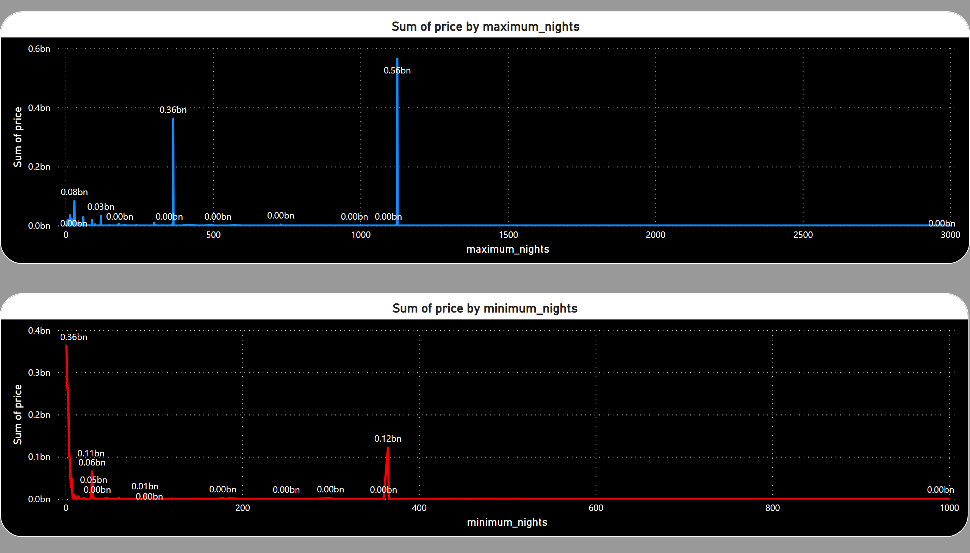
Page 6
Notes:
lineChart
No alt text provided
lineChart
No alt text provided

Slide 8
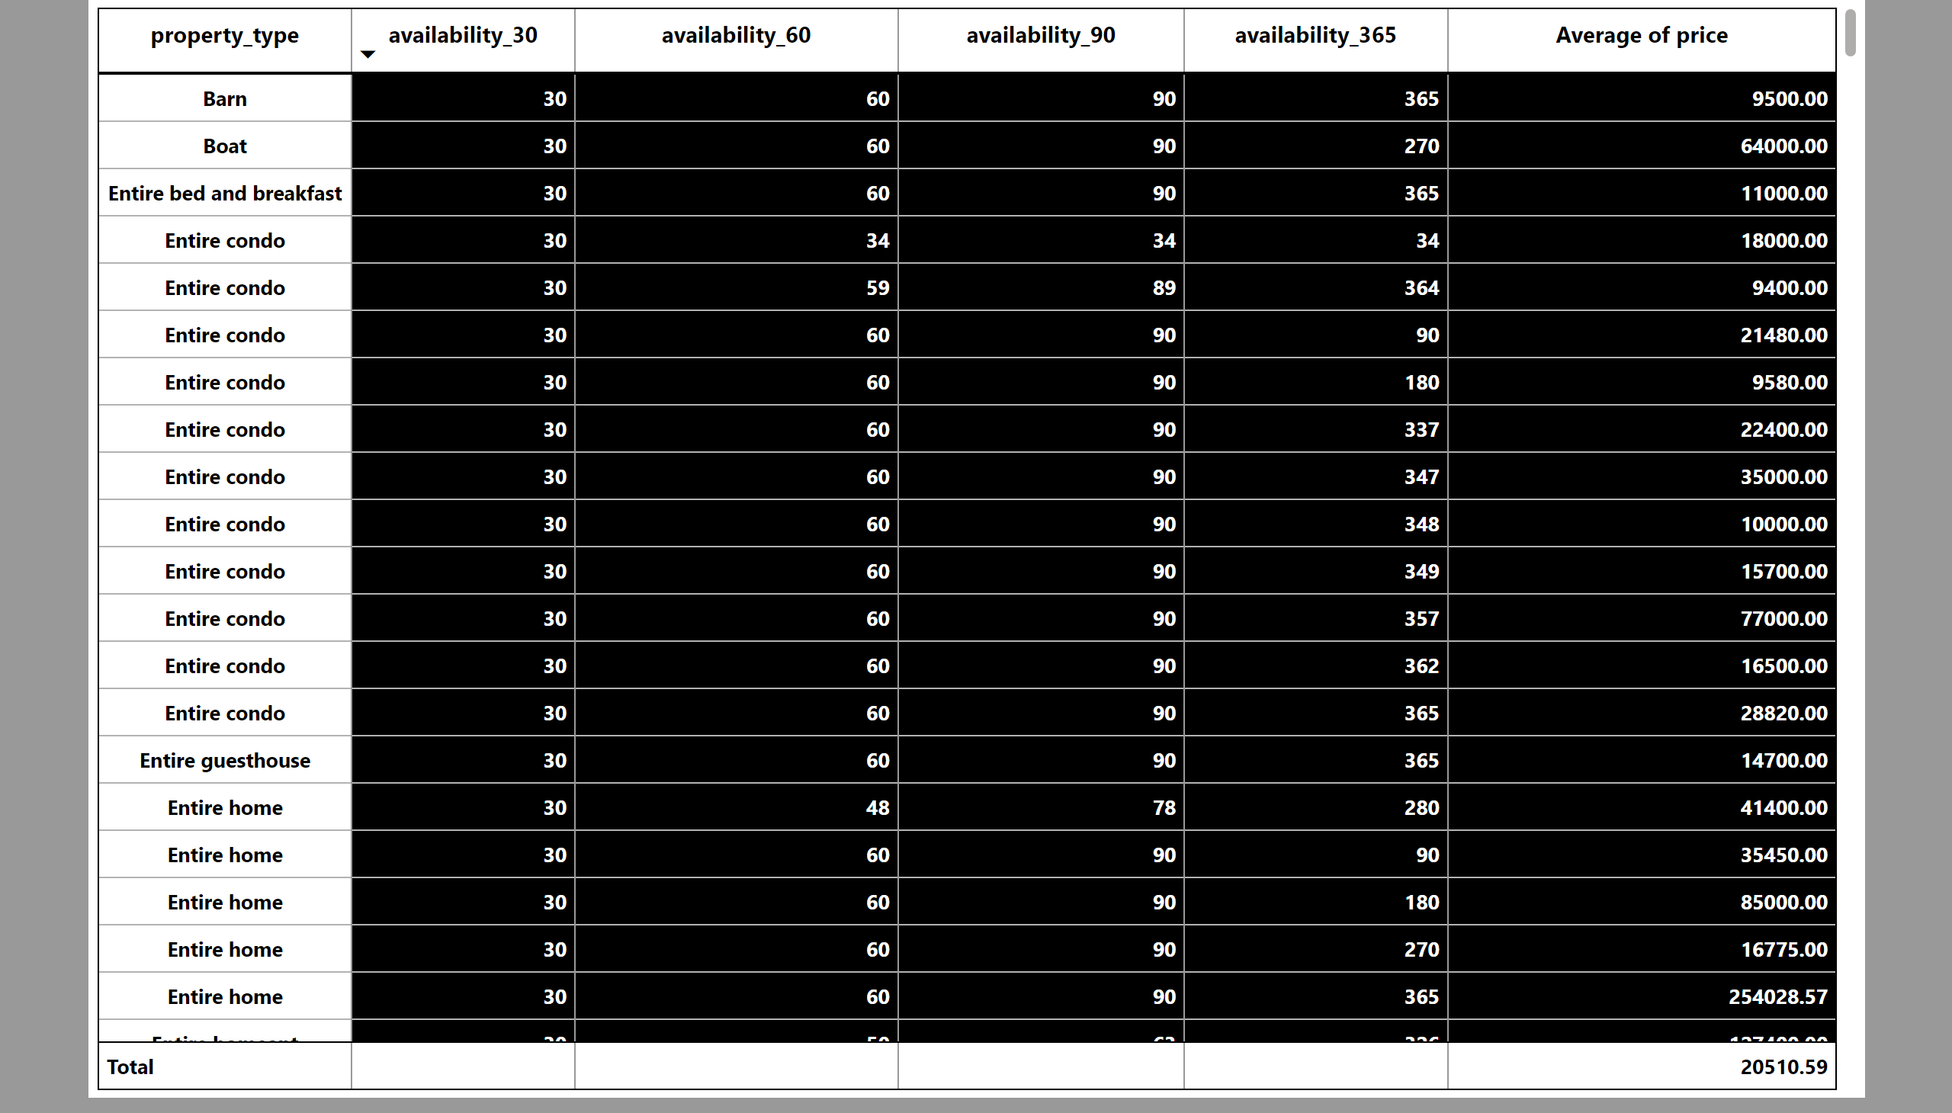
Page 7
Notes:
tableEx
No alt text provided

Slide 9
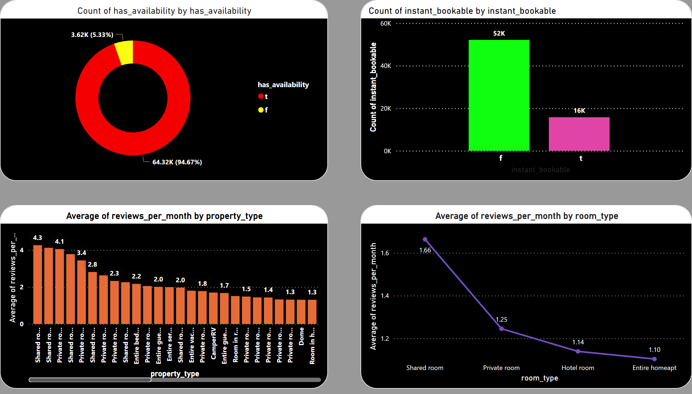
Page 8
Notes:
donutChart
No alt text provided
columnChart
No alt text provided
columnChart
No alt text provided
lineChart
No alt text provided

Slide 10
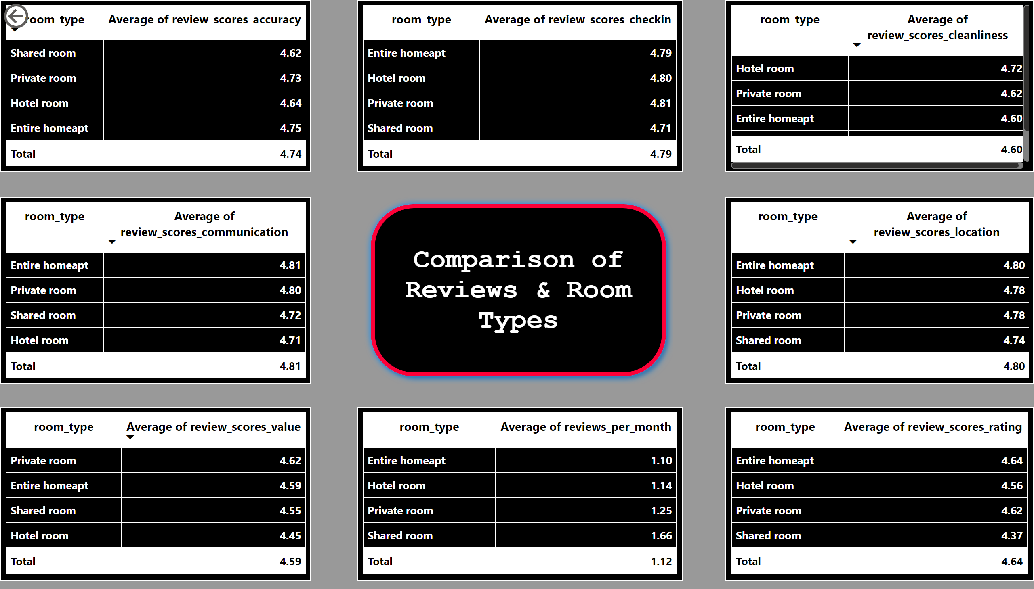
Page 9
Notes:
tableEx
No alt text provided
tableEx
No alt text provided
actionButton
No alt text provided
tableEx
No alt text provided
tableEx
No alt text provided
tableEx
No alt text provided
tableEx
No alt text provided
tableEx
No alt text provided
tableEx
No alt text provided
shape
No alt text provided

Slide 11
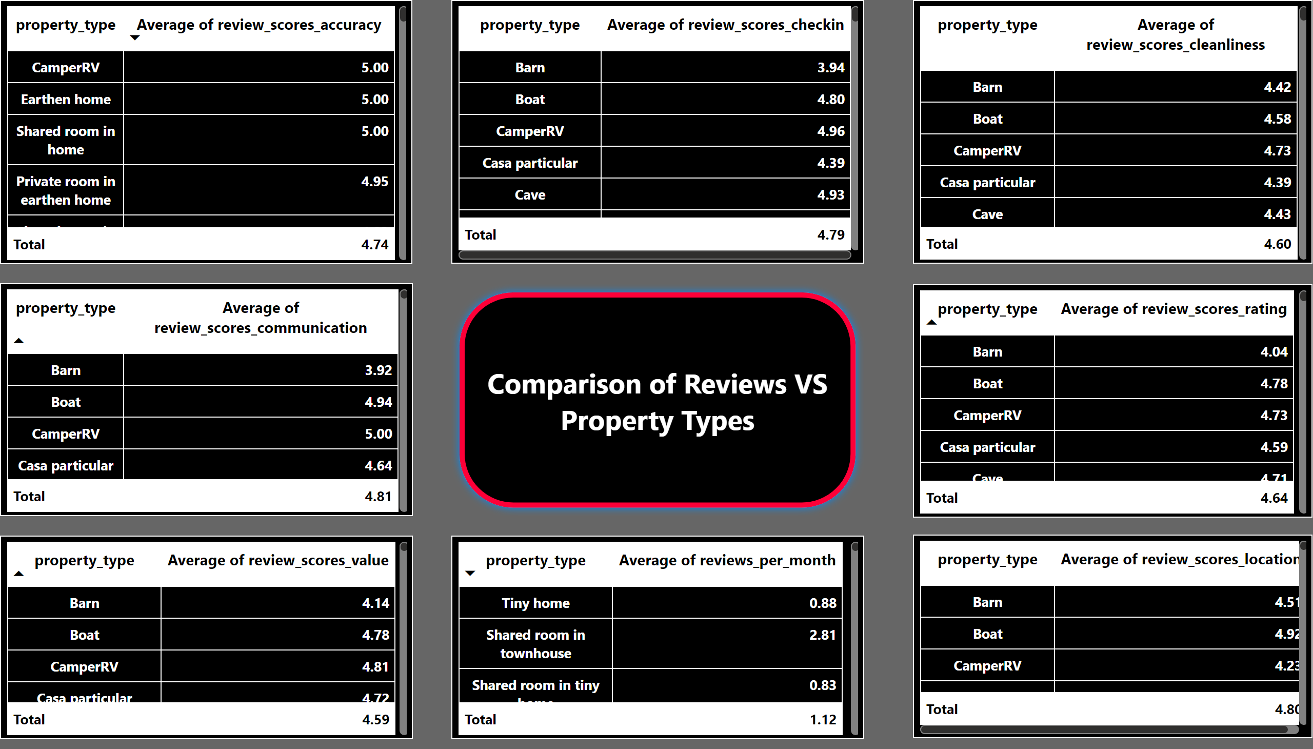
Page 10
Notes:
tableEx
No alt text provided
tableEx
No alt text provided
tableEx
No alt text provided
tableEx
No alt text provided
tableEx
No alt text provided
tableEx
No alt text provided
tableEx
No alt text provided
tableEx
No alt text provided
shape
No alt text provided

Slide 12
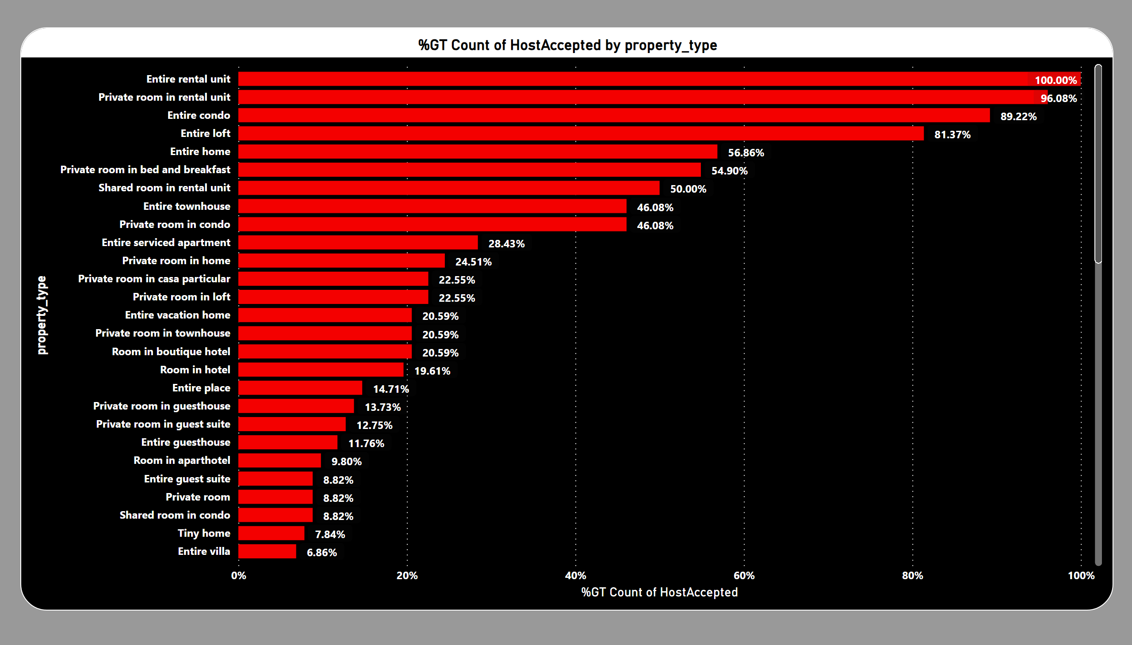
Page 11
Notes:
barChart
No alt text provided

Slide 13
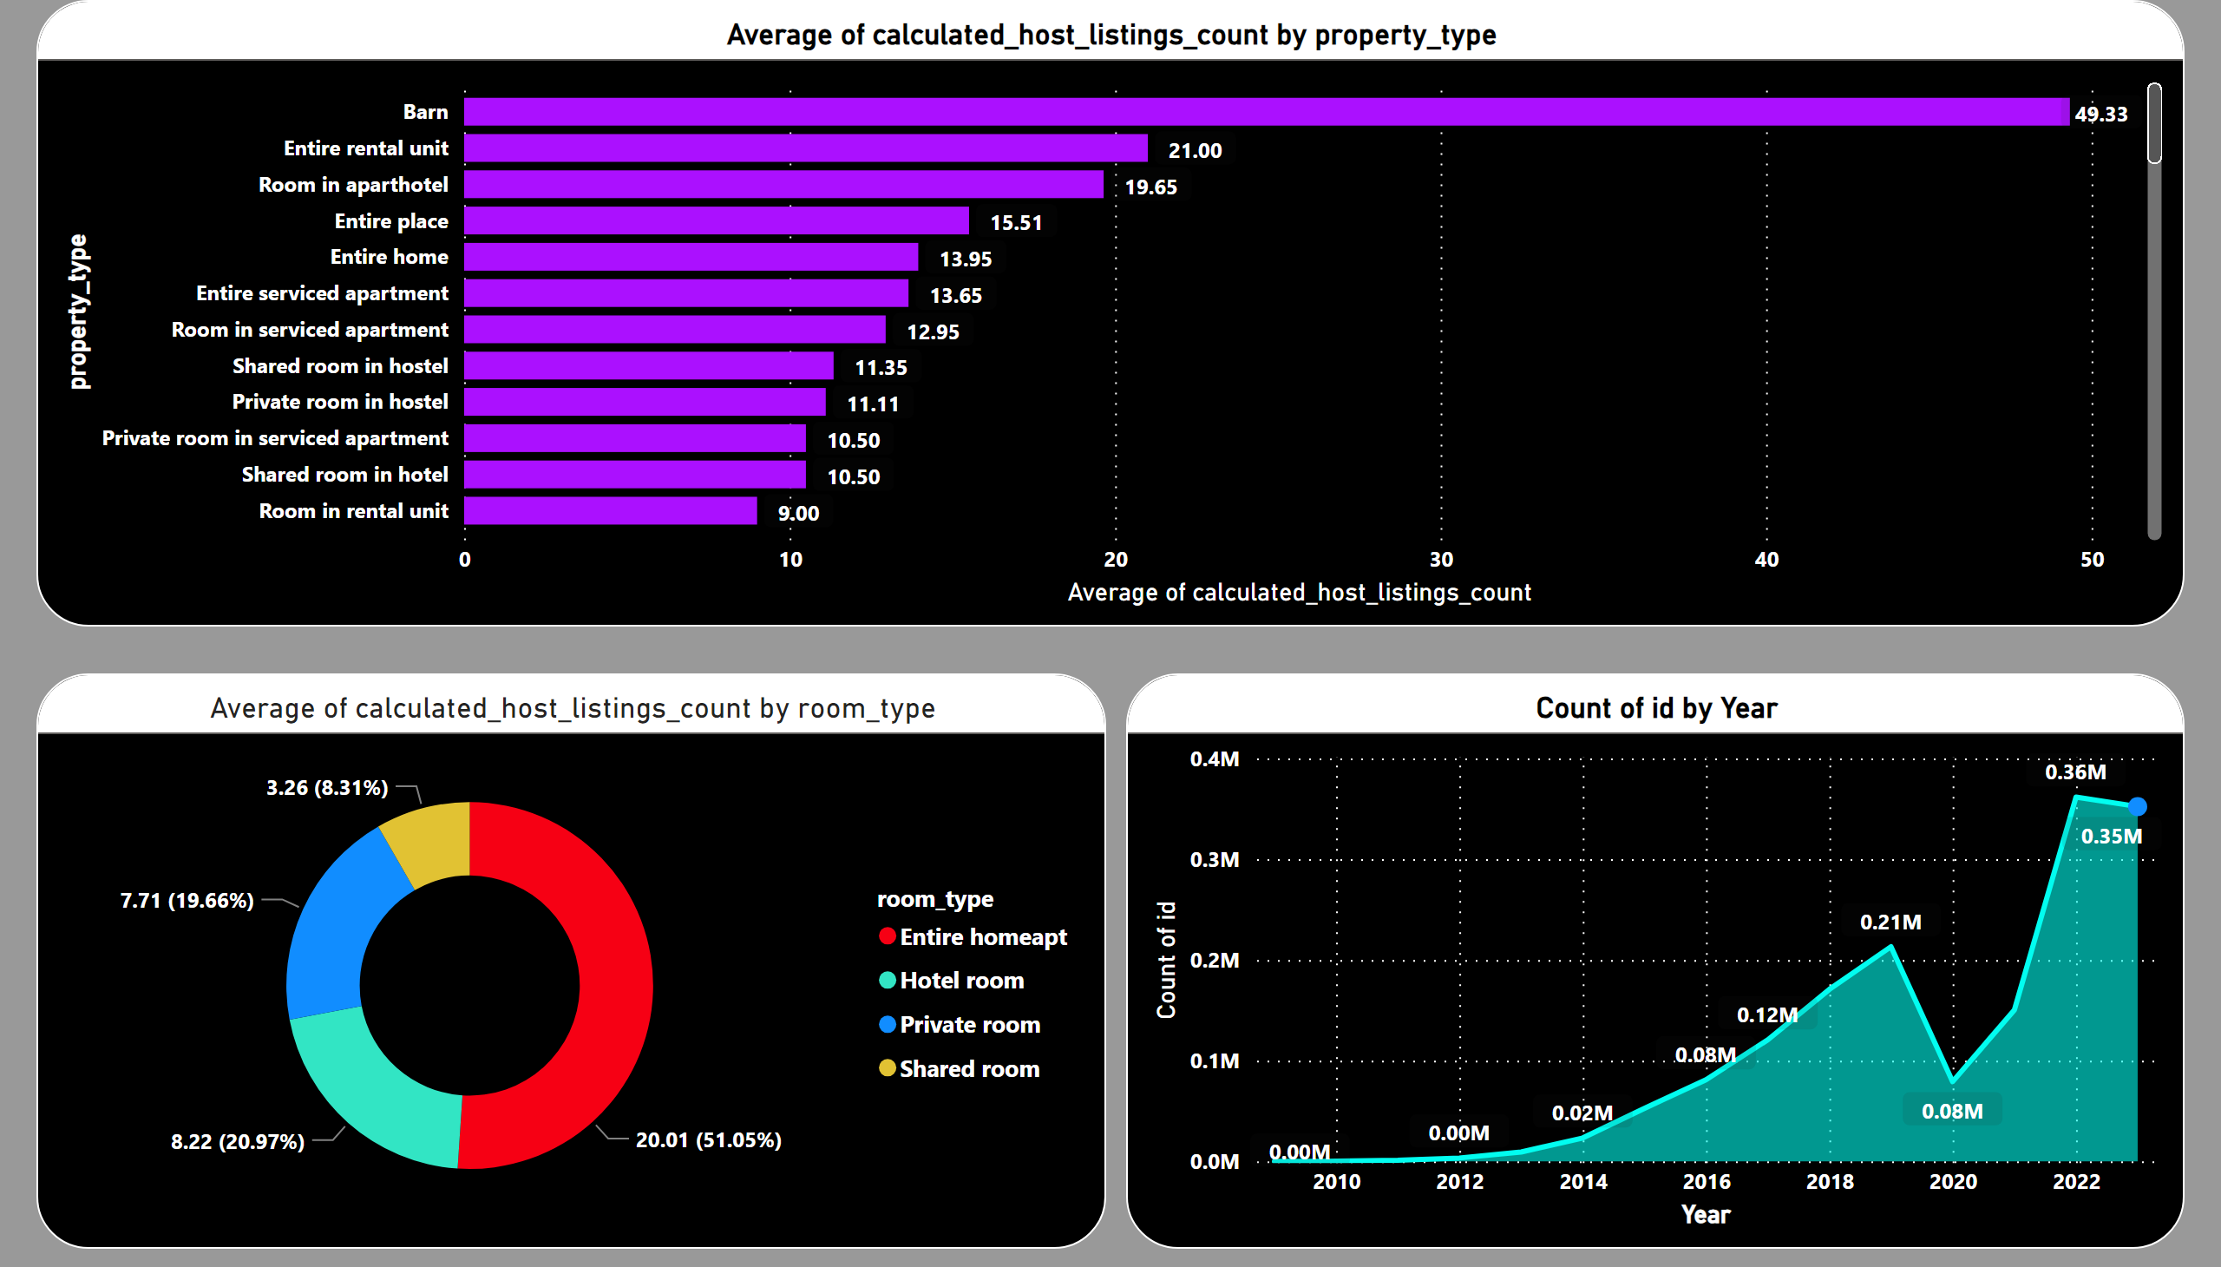
Page 12
Notes:
clusteredBarChart
No alt text provided
donutChart
No alt text provided
areaChart
No alt text provided

Slide 14
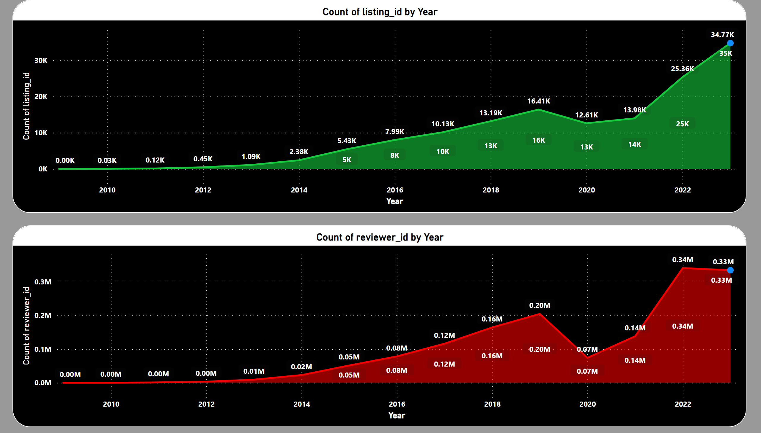
Page 13
Notes:
stackedAreaChart
No alt text provided
stackedAreaChart
No alt text provided

